Slide 1
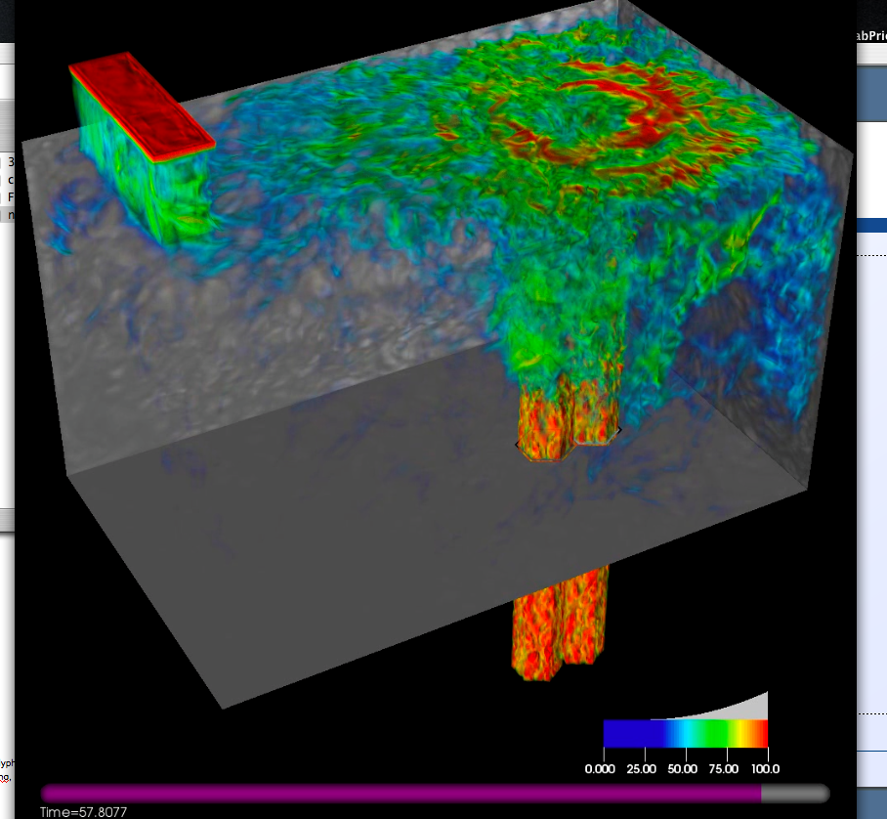
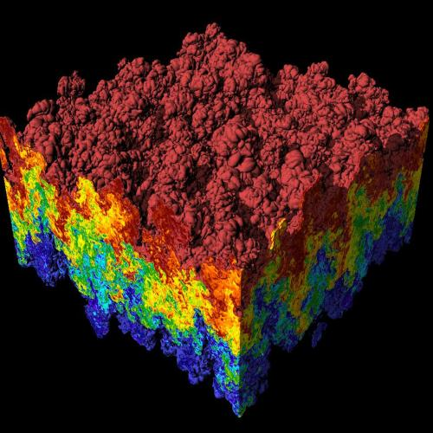
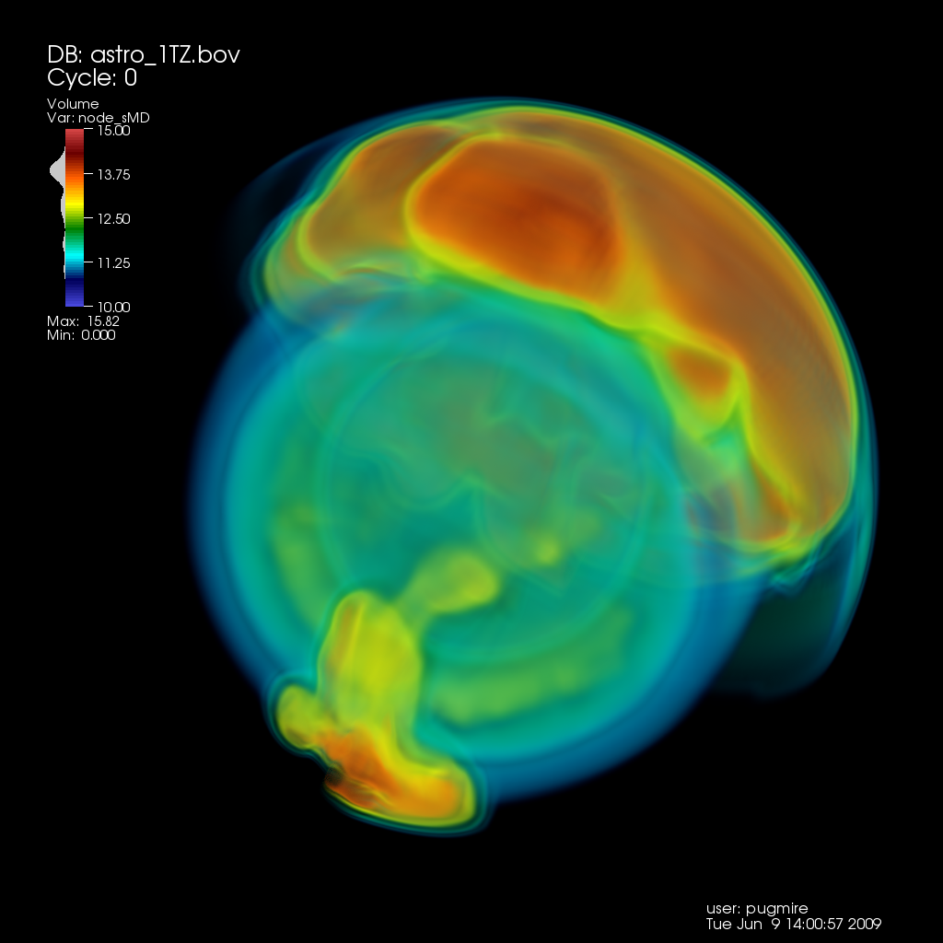
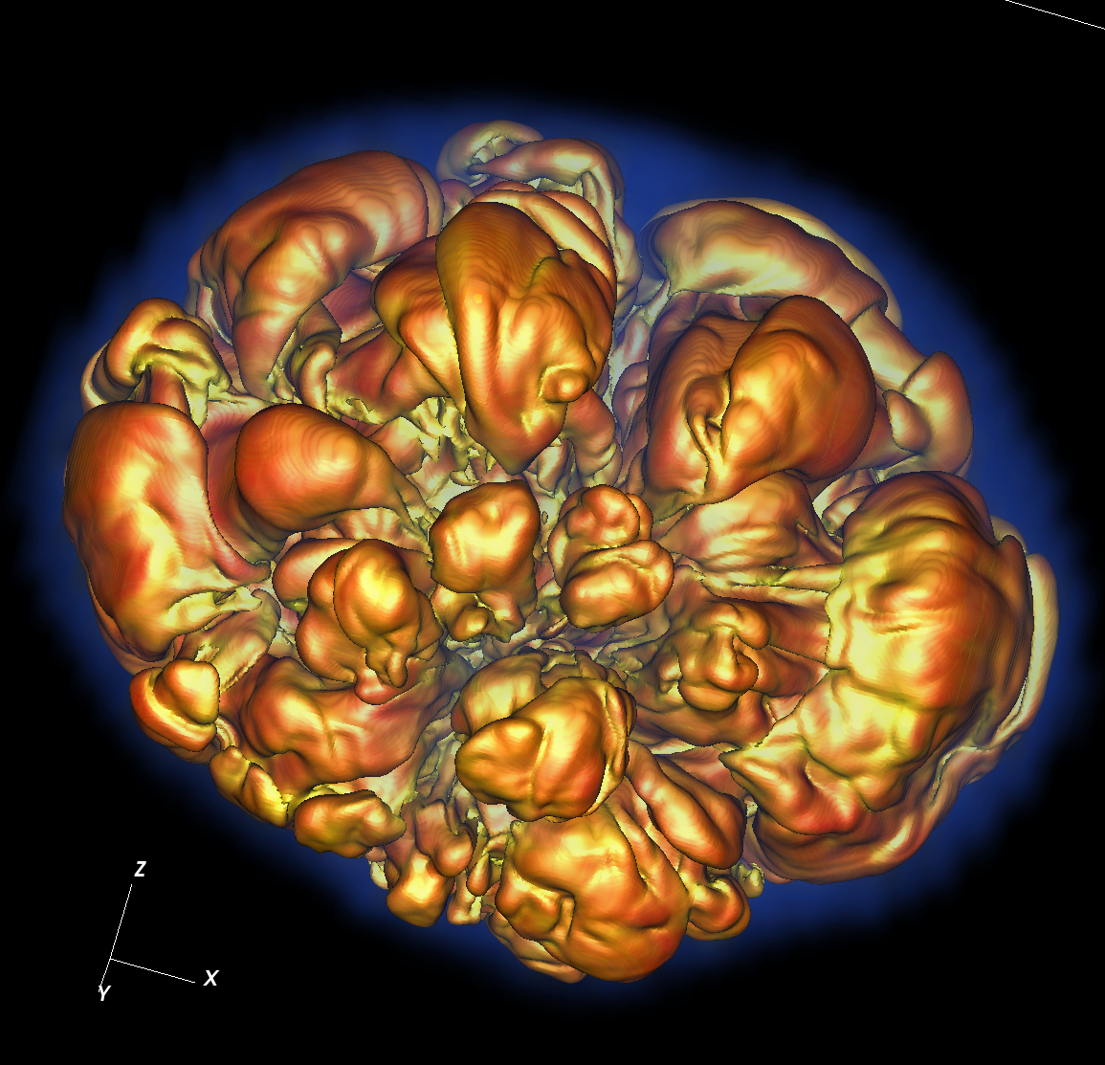
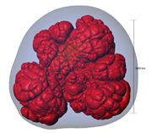
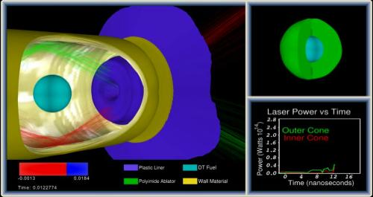
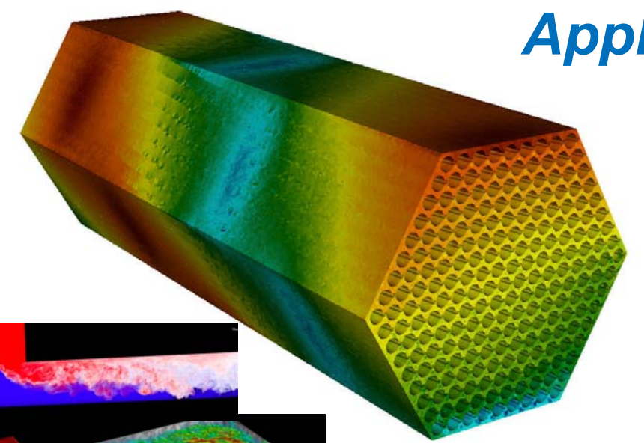
CIS 441/541: Intro to Computer Graphics Lecture 10&11: Even More OpenGL!
February 19/21, 2019
Hank Childs, University of Oregon

Slide 2
Office Hours: Week 7
Monday: 1-2 (Roscoe)
Tuesday: 1230-115 (Hank)
Tuesday: 1-2 (Roscoe)
Wednesday: 1-3 (Roscoe)
Thursday: 1130-1230 (Hank)
Friday: 1130-1230 (Hank)

Slide 3
Timeline (1/2)
1F: assigned Feb 7th, due Feb 19th
→ not as tough as 1E
2A: posted now, due Feb 21st Feb 23rd
→ you need to work on both 1F and 2A during Week 6 (Feb 11-15)
2B: posted now, due Feb 27th
YouTube lectures for Feb 12th and 14th

Slide 4
Timeline (2/2)
Sun | Mon | Tues | Weds | Thurs | Fri | Sat
Feb 3 | Feb 4 | Feb 5 Lec 8 | Feb 6 1E due | Feb 7 Begin 1F, begin 2A | Feb 8 | Feb 9
Feb 10 | Feb 11 | YouTube | Feb 13 | YouTube?? | Feb 15 | Feb 16
Feb 17 | Feb 18 | Feb 19 1F due | Feb 20 | Feb 21 2A due, begin 2B | Feb 22 | Feb 23 2A due

Slide 5
Midterm
Date: Tues Feb 26th
Considering different plan: 25 & 5
Still no feedback received
Details:
No notes.
Not expected to memorize Phong shading equation.
Will be derived directly from 1A-1F, 2A. Not 2B.

Slide 6
Midterm
Questions will mostly derive from Project 1A, 1B, 1C, 1D, 1E, 1F, 2A
Example: here’s a triangle, what pixels does it contribute to?
Example: write GL program to do something
errors in syntax will receive minor deductions
No notes, closed book, no calculators, internet, etc.

Slide 7
Questions on 1F?

Slide 8
Project #1F (8%), Due Feb 19th
Goal: add shading, movie
Extend your project1E code
Important:
add #define NORMALS

Slide 9
Changes to data structures
class Triangle
{
public:
double X[3], Y[3], Z[3];
double colors[3][3];
double normals[3][3];
};
reader1e.cxx::GetTriangles() will not compile (with #define NORMALS) until you make these changes
Now initializes normals at each vertex

Slide 10
More comments (1/3)
This project in a nutshell:
Add method called “CalculateShading”.
My version of CalculateShading is about ten lines of code.
Call CalculateShading for each vertex
This is a new field, which you will LERP.
Modify RGB calculation to use shading.

Slide 11
More comments (2/3)
Data to help debug
I will make the shading value for each pixel available.
I will also make it available for ambient, diffuse, specular.
Don’t forget to do two-sided lighting for diffuse, one-sided lighting for specular

Slide 12
More comments (3/3)
I haven’t said anything about movie encoders
ffmpeg

Slide 13
Questions on 2A?

Slide 14
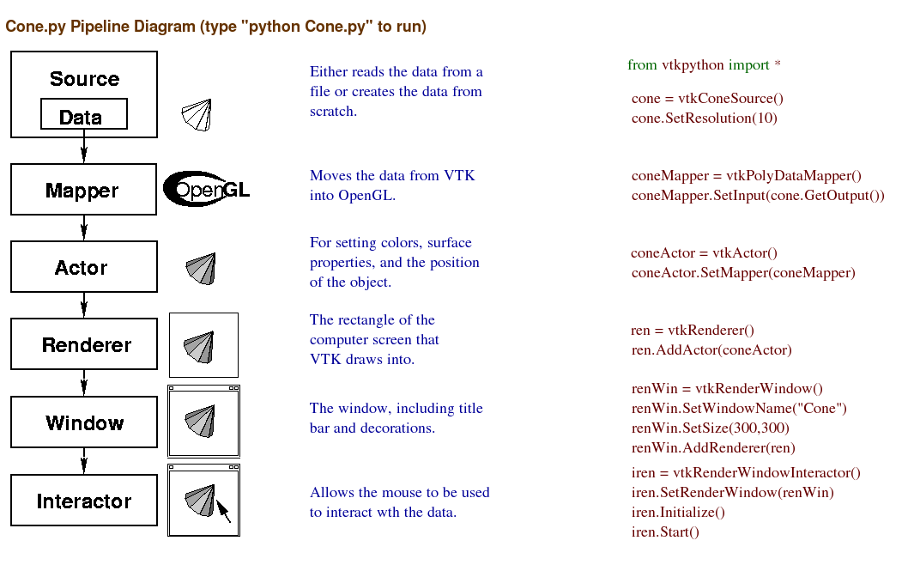
We will replace these and write our own GL calls.
We will re-use these.

Slide 15
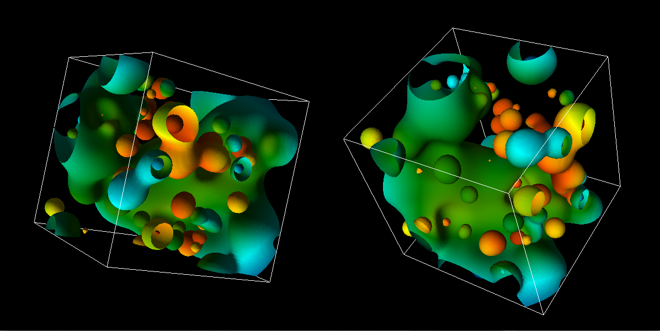
Project #2A (8%), Due Feb. 23rd
Goal: OpenGL program that does regular colors and textures
New VTK-based project2A.cxx
New CMakeLists.txt (but same as old ones)

Slide 16
Hints
I recommend you “walk before you run” & “take small bites”. OpenGL can be very punishing. Get a picture up and then improve on it. Make sure you know how to retreat to your previously working version at every step.
OpenGL “state thrashing” is common and tricky to debug.
Get one window working perfectly.
Then make the second one work perfectly.
Then try to get them to work together.
Things often go wrong, when one program leaves the OpenGL state in a way that doesn’t suit another renderer.

Slide 17
Hints
MAKE MANY BACKUPS OF YOUR PROGRAM
USE VTK 6
If you are having issues on your laptop with a GL program, then use Room 100
(There’s only 2 of these projects)

Slide 18
How to do colors (traditional)…
The Triangle class now has a “fieldValue” data member, which ranges between 0 and 1.
You will map this to a color using the GetColorMap function.
GetColorMap returns 256 colors.
Mappings
A fieldValue value of 0 should be mapped to the first color
A fieldValue value of 1 should be mapped to the 255th color.
Each fieldValue in between should be mapped to the closest color of the 256, but interpolation of colors is not required.

Slide 19
How to do colors (texture)…
Same idea, but use texture infrastructure
(easier)

Slide 20
More on Textures

Slide 21
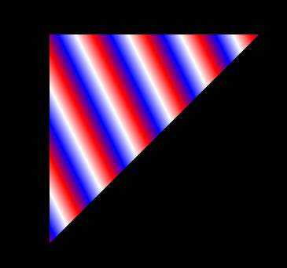
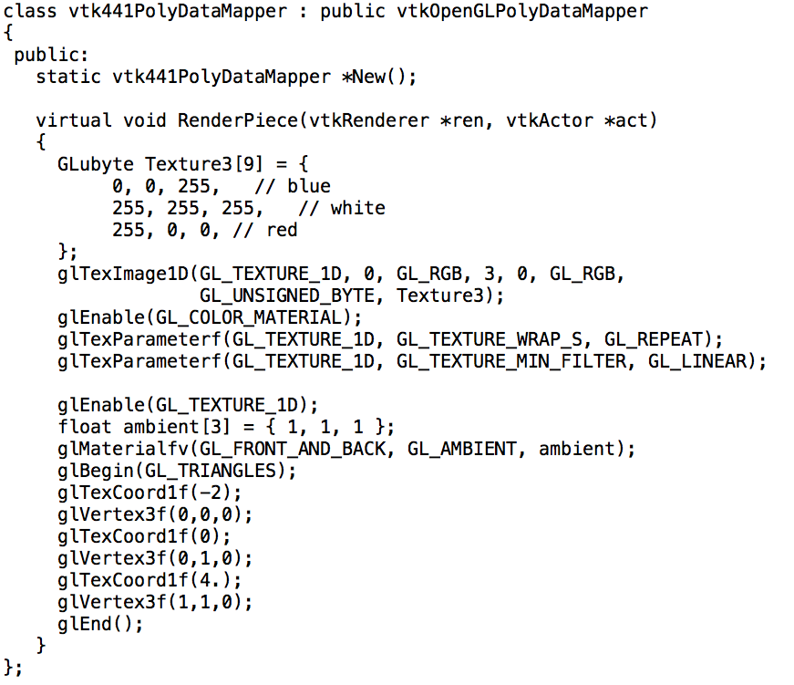
Textures with GL_REPEAT

Slide 22
1D, 2D, 3D textures
2D textures most common
1D textures: color maps (e.g., what we just did)
3D textures: “volume rendering”
Use combination of opacity
and color (i.e., RGBA)

Slide 23
2D Textures
Pre-rendered images painted onto geometry
glTexImage1D → glTexImage2D
GL_TEXTURE_WRAP_S → GL_TEXTURE_WRAP_S + GL_TEXTURE_WRAP_T
glTexCoord1f → glTexCoord2f

Slide 24

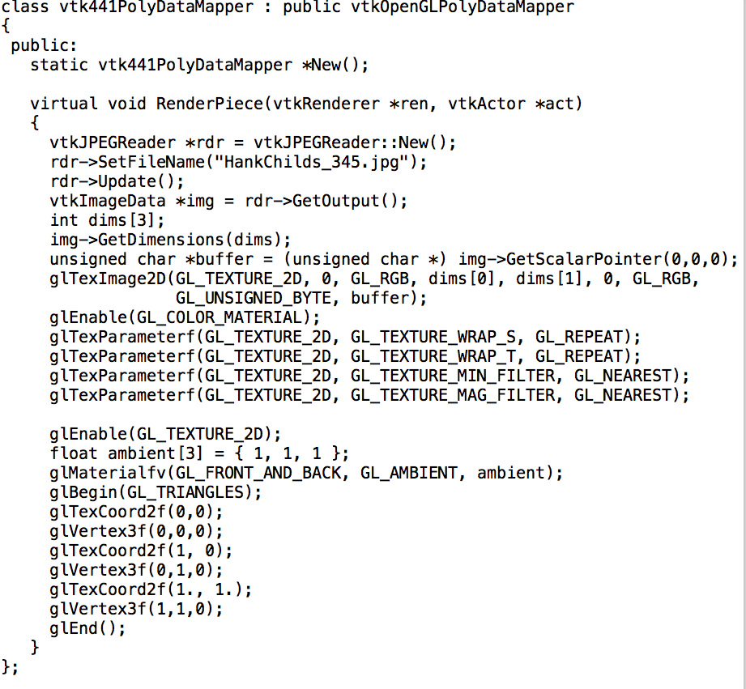
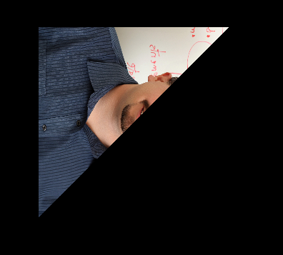
2D Texture Program
What do we expect the output to be?

Slide 25
GL_TEXTURE_MIN_FILTER / GL_TEXTURE_MAG_FILTER
Minifying: texture bigger than triangle.
How to map multiple texture elements onto a pixel?
GL_NEAREST: pick closest texture
GL_LINEAR: average neighboring textures
Magnifying (GL_TEXTURE_MAG_FILTER): triangle bigger than texture
How to map single texture element onto multiple pixels?
GL_NEAREST: no interpolation
GL_LINEAR: interpolate with neighboring textures

Slide 26
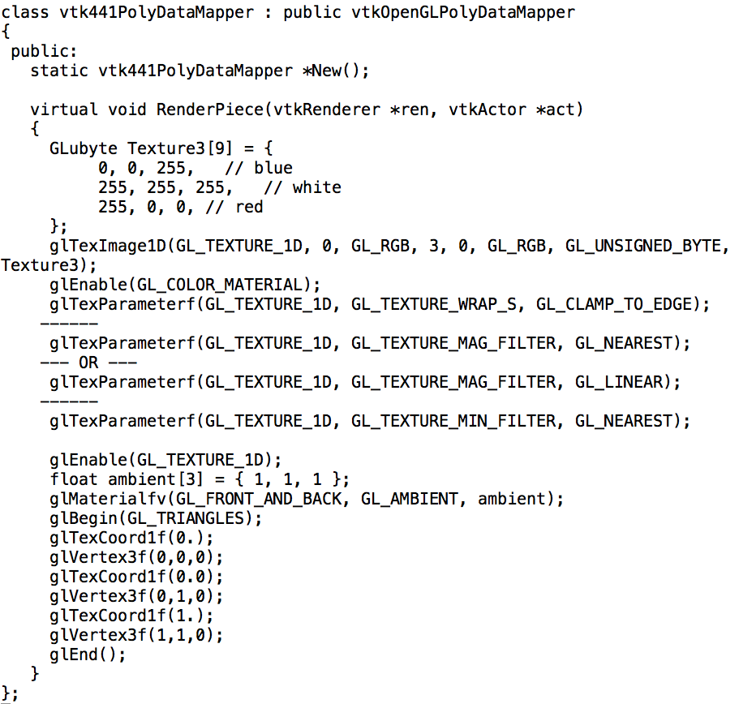
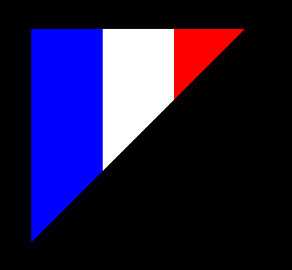
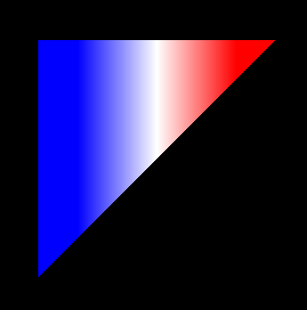
GL_TEXTURE_MAG_FILTER with NEAREST and LINEAR

Slide 27
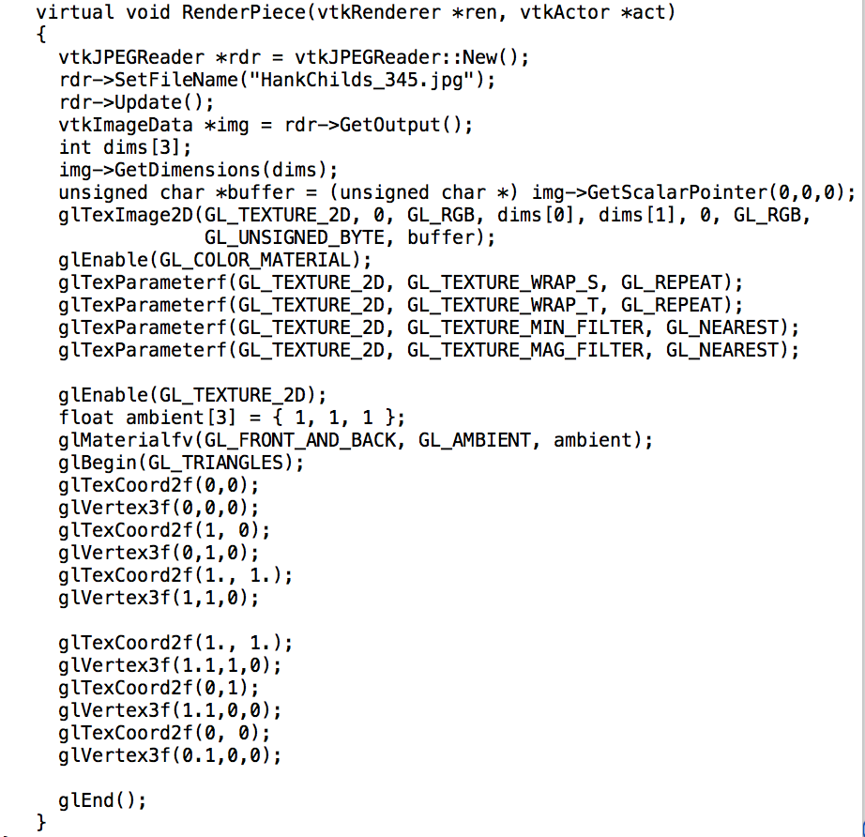
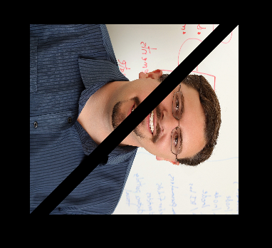
2D Texture Program
Texture is not 1:1, should probably scale geometry.
This is a terrible program … why?

Slide 28
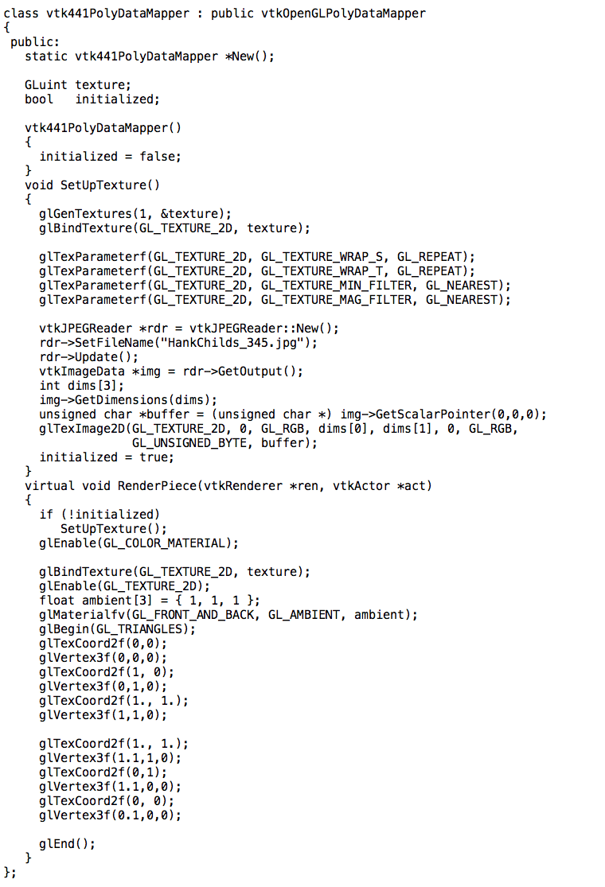
glBindTexture: tell the GPU about the texture once and re-use it!

Slide 29
More on Geometric Primitives

Slide 30
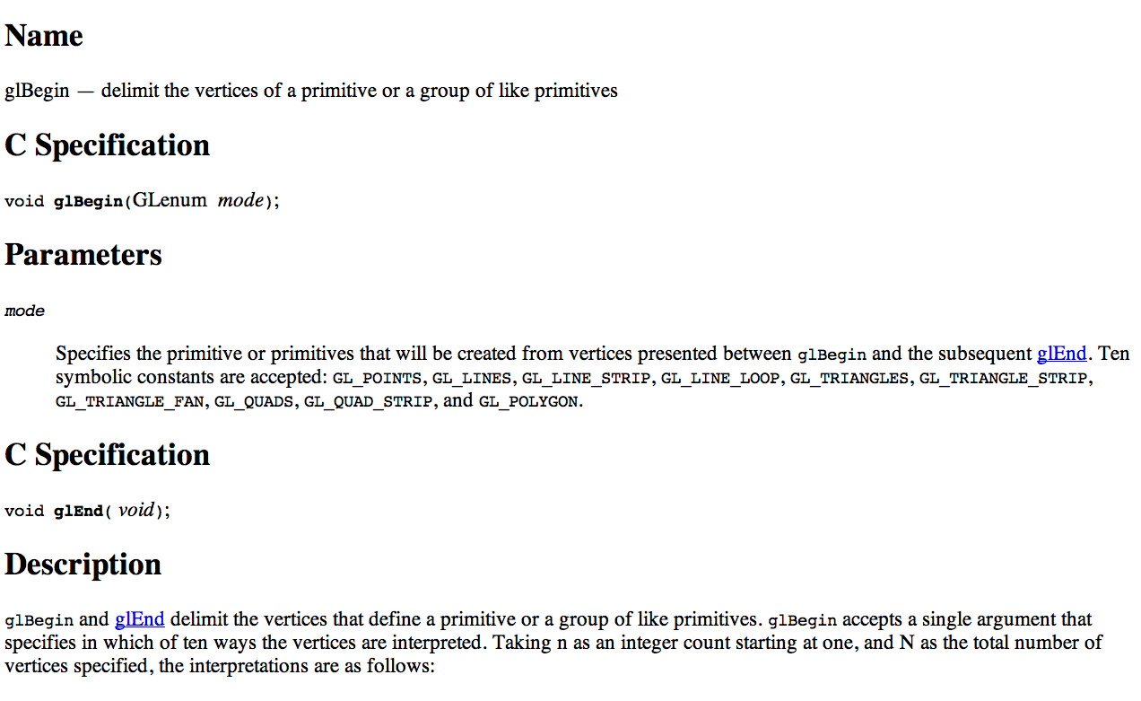
Geometric Specification: glBegin

Slide 31
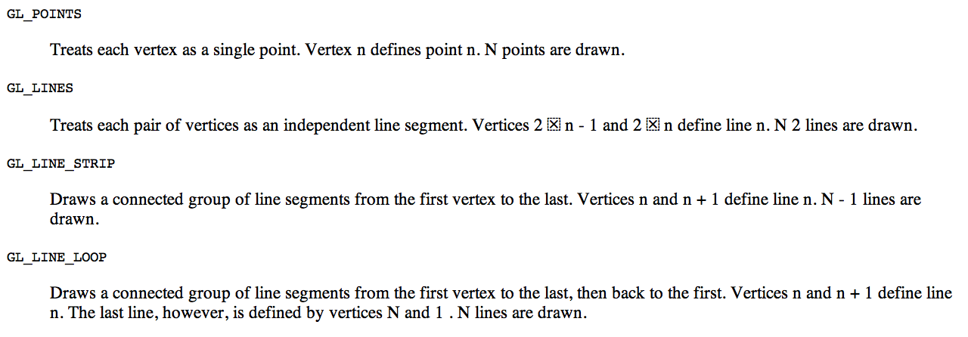
Geometric Primitives

Slide 32
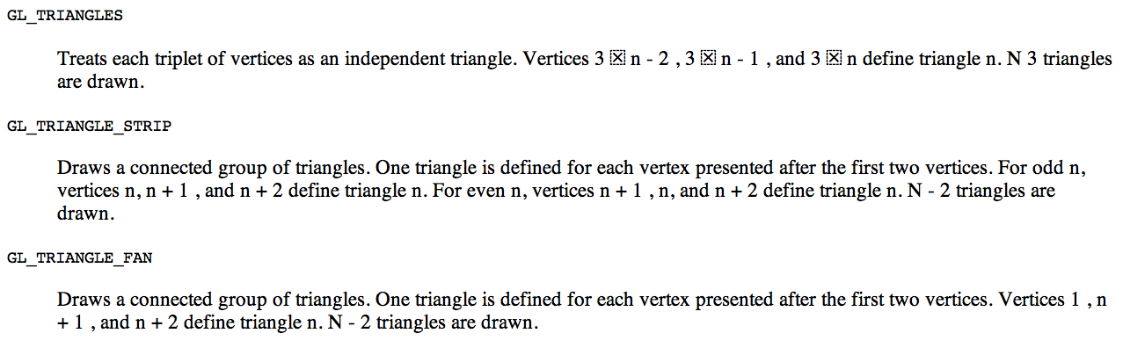
Geometric Primitives

Slide 33
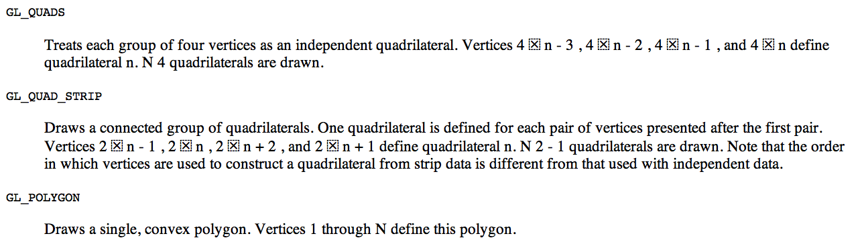
Geometric Primitives

Slide 34
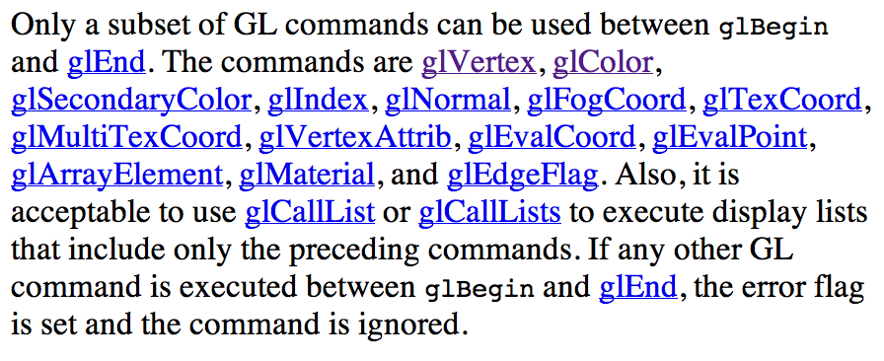
What can go inside a glBegin?

Slide 35
Lighting Model

Slide 36
Lighting
glEnable(GL_LIGHTING);
Tells OpenGL you want to have lighting.
Eight lights
Enable and disable individually
glEnable(GL_LIGHT0)
glDisable(GL_LIGHT7)
Set attributes individually
glLightfv(GL_LIGHTi, ARGUMENT, VALUES)

Slide 37
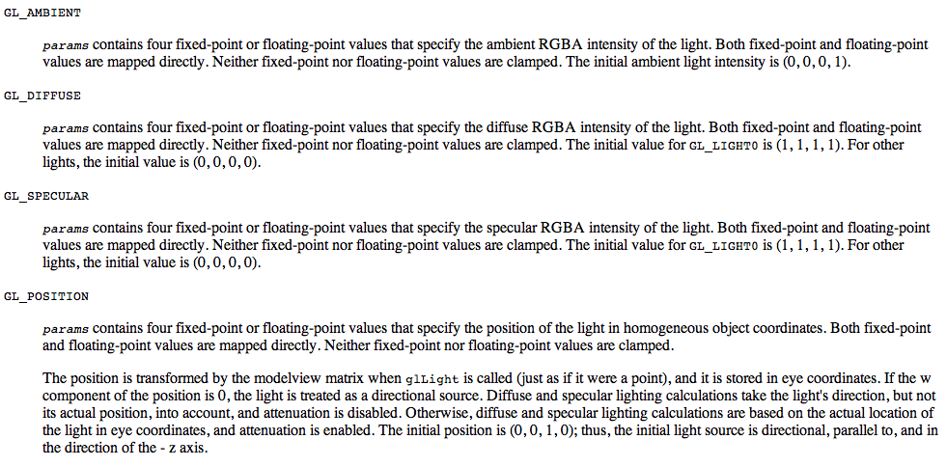
glLightfv parameters
Ten parameters (ones you will use):

Slide 38
glLightfv in action
For each light source, we can set an RGBA for the diffuse, specular, and ambient components:
glEnable(GL_LIGHTING);
glEnable(GL_LIGHT0);
Glfloat diffuse0[4] = { 0.7, 0.7, 0.7, 1 };
glLightfv(GL_LIGHT0, GL_DIFFUSE, diffuse0);
… // set ambient, specular, position
glDisable(GL_LIGHT1); // do we need to do this?
…
glDisable(GL_LIGHT7); // do we need to do this?

Slide 39
How do we tell OpenGL about the surface normals?
Flat shading:
glNormal3f(0, 0.707, -0.707);
glVertex3f(0, 0, 0);
glVertex3f(1, 1, 0);
glVertex3f(1, 0, 0);
Smooth shading:
glNormal3f(0, 0.707, -0.707);
glVertex3f(0, 0, 0);
glNormal3f(0, 0.707, +0.707);
glVertex3f(1, 1, 0);
glNormal3f(1, 0, 0);
glVertex3f(1, 0, 0);

Slide 40
Distance and Direction
The source colors are specified in RGBA
The position is given in homogeneous coordinates
If w =1.0, we are specifying a finite location
If w =0.0, we are specifying a parallel source with the given direction vector

Slide 41
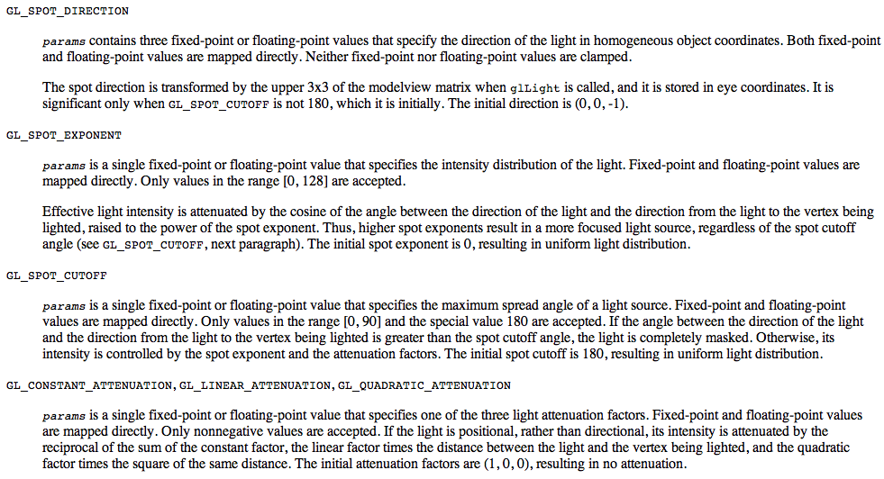
glLightfv parameters (2)
Ten parameters (ones you will never use)

Slide 42
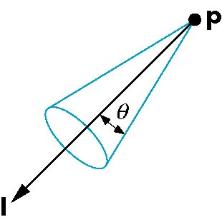
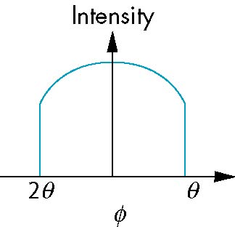
Spotlights
Use glLightv to set
Direction GL_SPOT_DIRECTION
Cutoff GL_SPOT_CUTOFF
Attenuation GL_SPOT_EXPONENT
Proportional to cos^{α}φ
−θ
φ
θ
42

Slide 43
What happens with multiple lights?
glEnable(GL_LIGHT0);
glEnable(GL_LIGHT1);
→ the effects of these lights are additive.
Individual shading factors are added and combined
Effect is to make objects brighter and brighter
Same as handling of high specular factors for 1E

Slide 44
Global Ambient Light
Ambient light depends on color of light sources
A red light in a white room will cause a red ambient term that disappears when the light is turned off
OpenGL also allows a global ambient term that is often helpful for testing
glLightModelfv(GL_LIGHT_MODEL_AMBIENT, global_ambient)
VTK turns this on by default!
Affects lighting of materials colored with glColor, but not glTexCoord1f!!

Slide 45
Shading Model

Slide 46
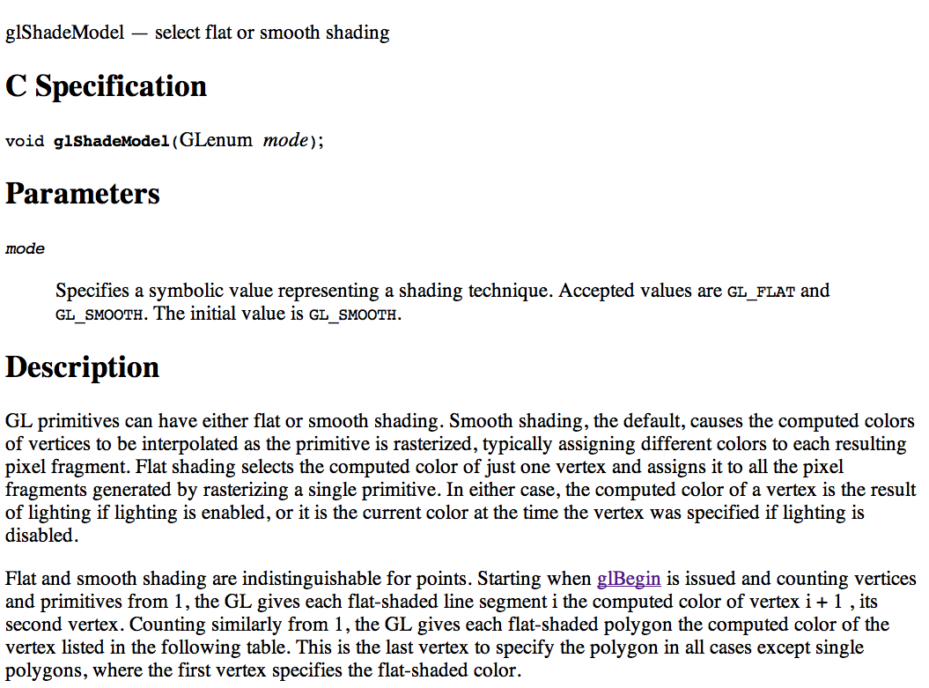
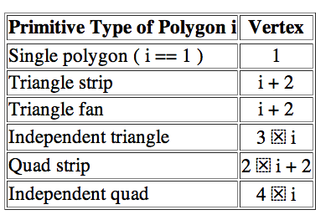
glShadeModel

Slide 47
Polygonal Shading
Shading calculations are done for each vertex
Vertex colors become vertex shades
By default, vertex shades are interpolated across the polygon
glShadeModel(GL_SMOOTH);
If we use glShadeModel(GL_FLAT); the color at the first vertex will determine the shade of the whole polygon
We will come back to this in a few slides

Slide 48
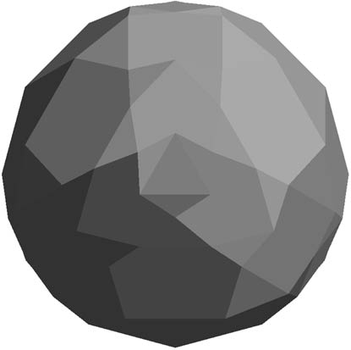
Flat Shading
*IF* polygons have a single normal
Shades at the vertices as computed by the Phong model can be almost same
Identical for a distant viewer (default) or if there is no specular component
Example: model of sphere

Slide 49
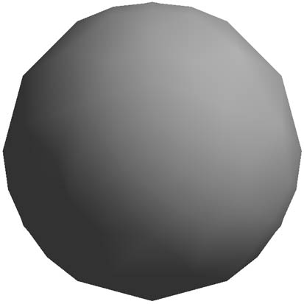
Smooth Shading
Normal at each vertex
Easy for sphere model
If centered at origin n = p
Now smooth shading works
Note silhouette edge

Slide 50
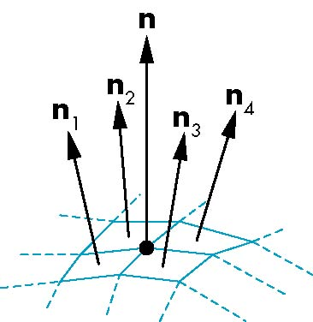
Mesh Shading
The previous example is not general because we knew the normal at each vertex analytically
For polygonal models, Gouraud proposed we use the average of the normals around a mesh vertex
n = (n₁+n₂+n₃+n₄)/ |n₁+n₂+n₃+n₄|

Slide 51
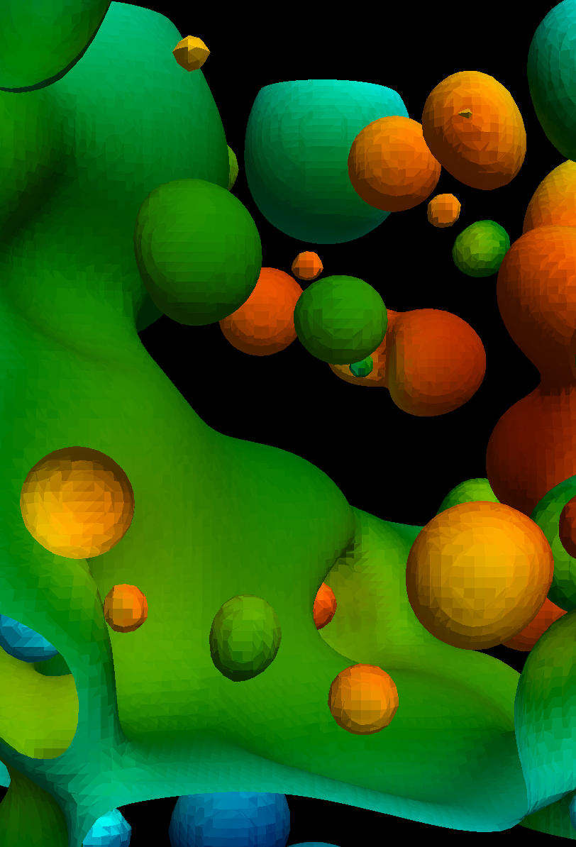

glShadeModel
glShadeModel
affects normals and colors

Slide 52
Material Model

Slide 53
glMaterial: coarser controls for color
You specify how much light is reflected for the material type.
Command:
glMaterialfv(FACE_TYPE, PARAMETER, VALUE(S))
FACE_TYPE =
GL_FRONT_AND_BACK
GL_FRONT
GL_BACK
(We will talk about this later)

Slide 54
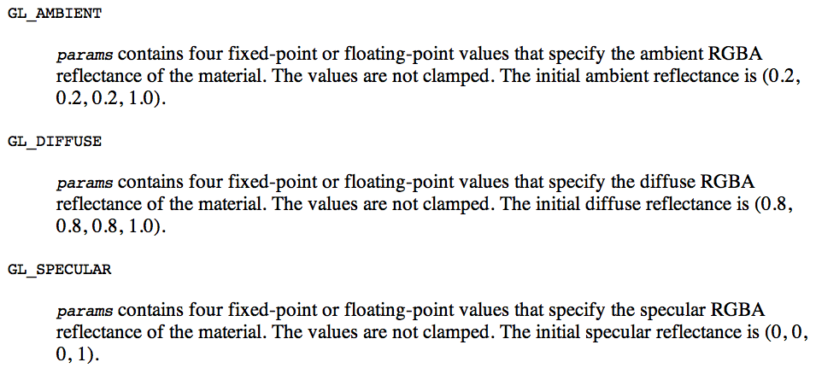
glMaterialfv Parameters

Slide 55
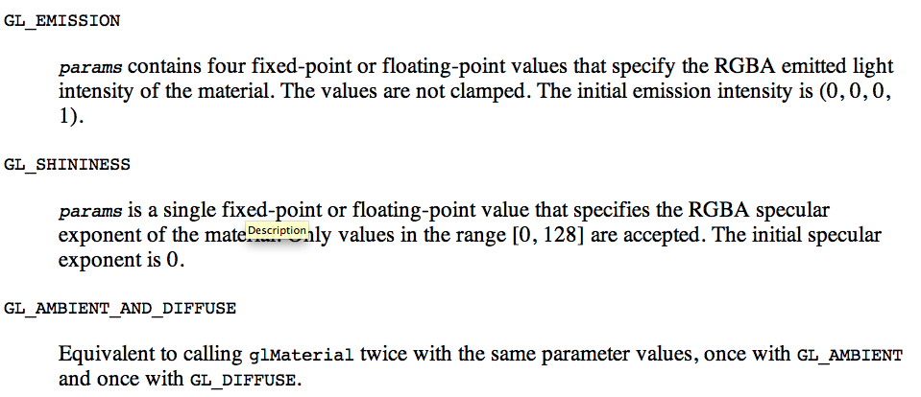
glMaterialfv Parameters

Slide 56
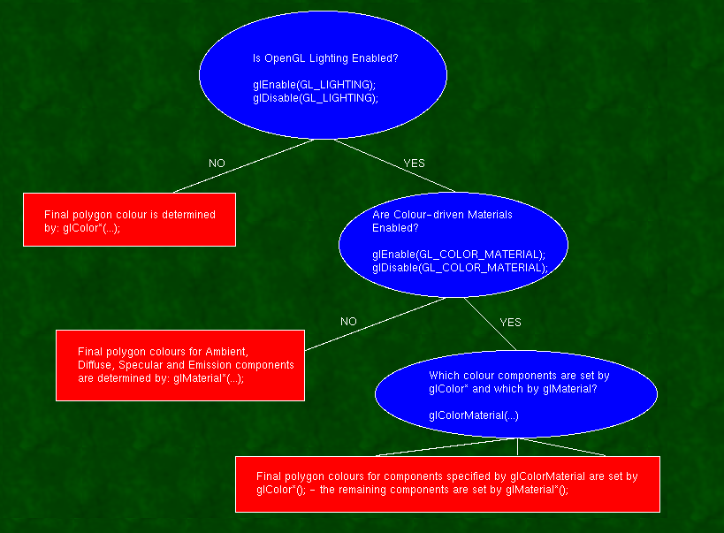
OpenGL: very complex model for lighting and colors
glMaterial not used
glColor
is no-op
http://www.sjbaker.org/steve/omniv/opengl_lighting.html

Slide 57
Basic OpenGL light model
The OpenGL light model presumes that the light that reaches your eye from the polygon surface arrives by four different mechanisms:
AMBIENT
DIFFUSE
SPECULAR
EMISSION - in this case, the light is actually emitted by the polygon - equally in all directions.
http://www.sjbaker.org/steve/omniv/opengl_lighting.html

Slide 58
Difference between lights and materials
There are three light colors for each light:
Ambient, Diffuse and Specular (set with glLight)
There are four colors for each surface:
Same three + Emission(set with glMaterial)
All OpenGL implementations support at least eight light sources - and the glMaterial can be changed at will for each polygon
http://www.sjbaker.org/steve/omniv/opengl_lighting.html

Slide 59
Interactions between lights and materials
The final polygon colour is the sum of all four light components, each of which is formed by multiplying the glMaterial colour by the glLight colour (modified by the directionality in the case of Diffuse and Specular).
Since there is no Emission colour for the glLight, that is added to the final colour without modification.
http://www.sjbaker.org/steve/omniv/opengl_lighting.html

Slide 60
Display Lists

Slide 61
CPU and GPU
Most common configuration has CPU and GPU on separate dies
I.e., plug GPU in CPU
CPU
(typically 4-12 cores, ~10GFLOPs)
GPU
(typically 100-1000 cores, ~100GFLOPs-~1000GFLOPs)
PCIe
Peripheral Component Interconnect Express
What are the performance ramifications of this architecture?

Slide 62
Display lists
Idea:
send geometry and settings to GPU once, give it an identifier
GPU stores geometry and settings
Just pass the identifier for every subsequent render

Slide 63
Display lists
Generate an idenfitier:
GLUint displayList = glGenLists(1);
Tell GPU that all subsequent geometry is part of the list:
glNewList(displayList,GL_COMPILE);
Specify geometry (i.e., glVertex, etc)
Tell GPU we are done specifying geometry:
glEndList();
Later on, tell GPU to render all the geometry and settings associated with our list:
glCallList(displayList);

Slide 64
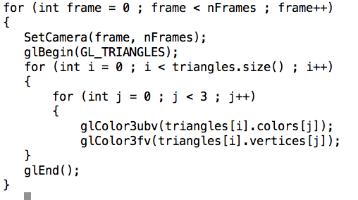
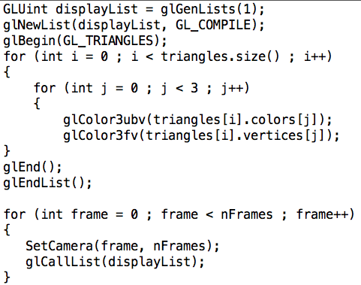
Display lists in action
What are the performance ramifications between the two?

Slide 65
glNewList
GL_COMPILE
Make the display list for later use.
GL_COMPILE_AND_EXECUTE
Make the display list and also execute it as you go.

Slide 66
Why is My 2A Rendering Slow?

Slide 67
Transforms in GL

Slide 68
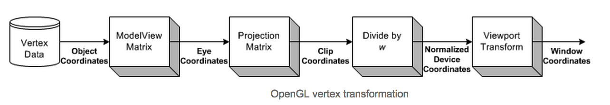
ModelView and Projection Matrices
New for us
Familiar for us
ModelView idea: two purposes … model and view
Model: extra matrix, just for rotating, scaling, and translating geometry.
How could this be useful?
View: Cartesian to Camera transform
(We will focus on the model part of the modelview matrix now & come back to others later)

Slide 69
SLIDE REPEAT: Our goal
Add additional transforms here….
O
O
World space:
Triangles in native Cartesian coordinates
Camera located anywhere
Camera space:
Camera located at origin, looking down -Z
Triangle coordinates relative to camera frame
z
y
x
Image space:
All viewable objects within
-1 <= x,y,z <= +1
Screen space:
All viewable objects within
-1 <= x, y <= +1
Device space:
All viewable objects within
0<=x<=width, 0 <=y<=height

Slide 70
ModelView and Projection Matrices
New for us
Familiar for us
ModelView idea: two purposes … model and view
Model: extra matrix, just for rotating, scaling, and translating geometry.
How could this be useful?
View: Cartesian to Camera transform
(We will focus on the model part of the modelview matrix now & come back to others later)

Slide 71
Common commands for modifying model part of ModelView matrix
glTranslate
glRotate
glScale

Slide 72
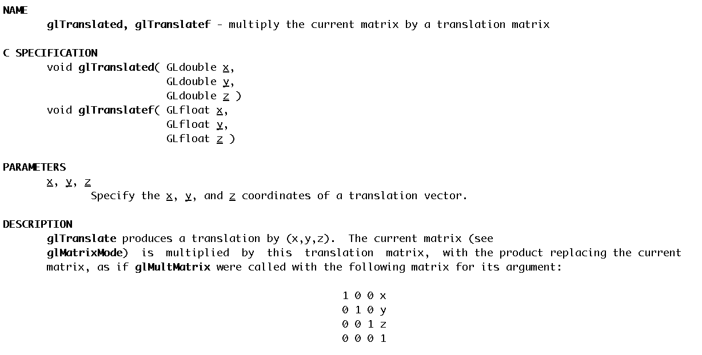
glTranslate
Note: this matrix transposed
from what we did earlier

Slide 73
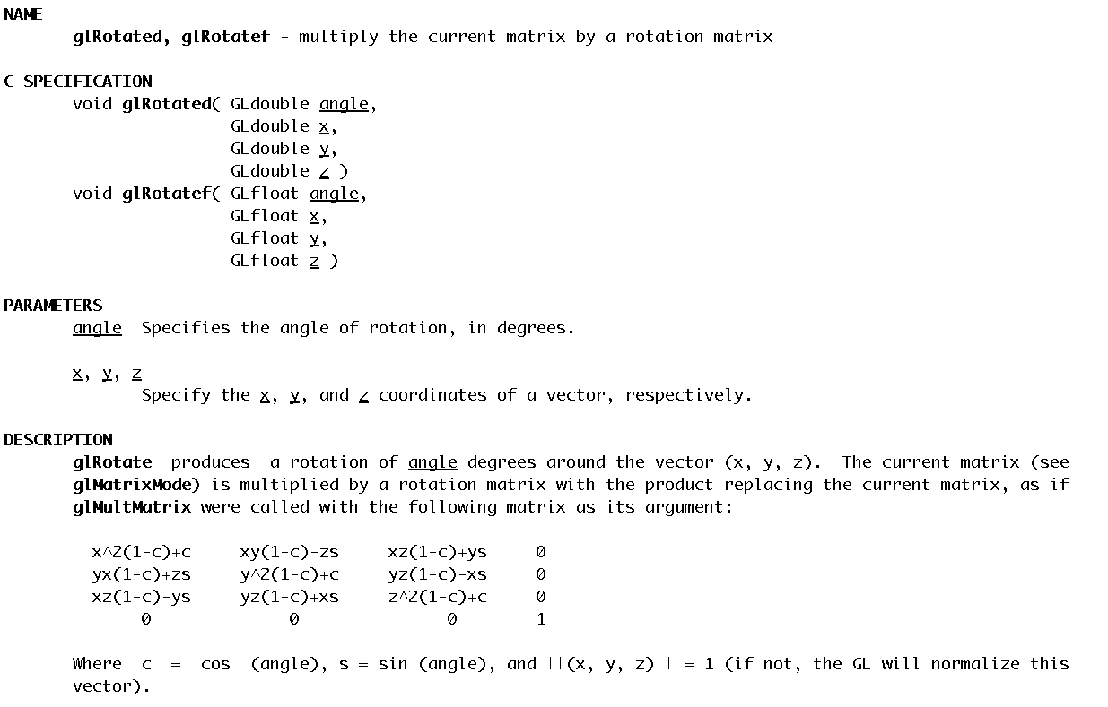
glRotate

Slide 74
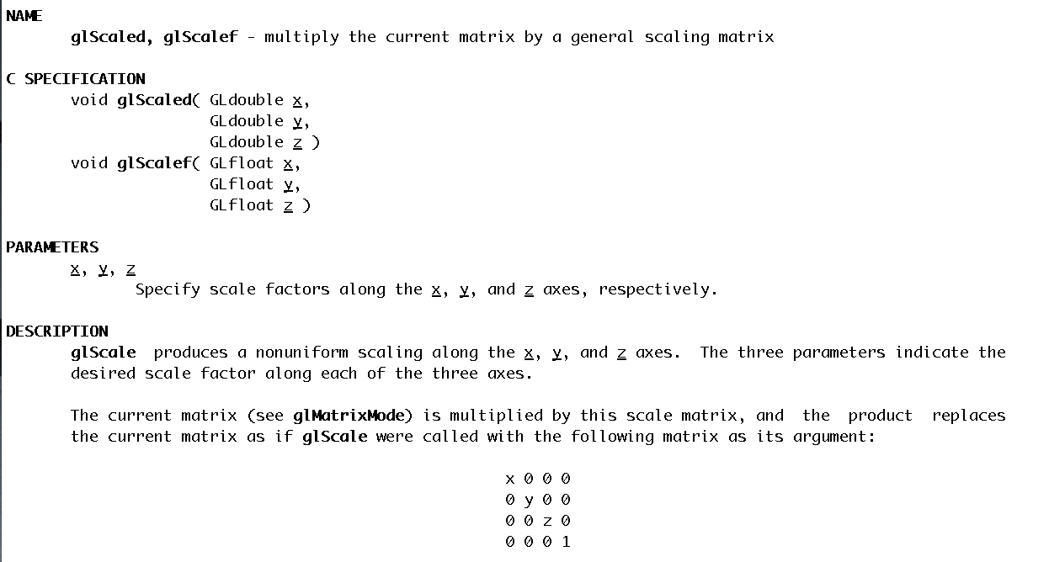
glScale

Slide 75
How do transformations combine?
glScale(2, 2, 2)
glTranslate(1, 0, 0)
glRotate(45, 0, 1, 0)
Rotate by 45 degrees around (0,1,0), then translate in X by 1, then scale by 2 in all dimensions.
(the last transformation is applied first)

Slide 76
Which of two of these three are the same?
Choice A:
glScalef(2, 2, 2);
glTranslate(1, 0, 0);
Choice B:
glTranslate(1, 0, 0);
glScalef(2, 2, 2);
Choice C:
glTranslate(2, 0, 0);
glScalef(2, 2, 2);

Slide 77
ModelView usage
dl = GenerateTireGeometry();
glCallList(dl); // place tire at (0, 0, 0)
glTranslatef(10, 0, 0);
glCallList(dl); // place tire at (10, 0, 0)
glTranslatef(0, 0, 10);
glCallList(dl); // place tire at (10, 0, 10)
glTranslatef(-10, 0, 0);
glCallList(dl); // place tire at (0, 0, 10)
Each glTranslatef call updates the state of the ModelView matrix.

Slide 78
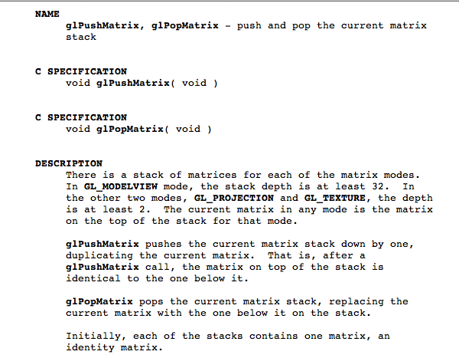
glPushMatrix, glPopMatrix

Slide 79
glPushMatrix and glPopMatrix
dl = GenerateTireGeometry();
glCallList(dl); // place tire at (0, 0, 0)
glPushMatrix();
glTranslatef(10, 0, 0);
glCallList(dl); // place tire at (10, 0, 0)
glPopMatrix();
glPushMatrix();
glTranslatef(0, 0, 10);
glCallList(dl); // place tire at (10, 0, 10) (0, 0, 10)
glPopMatrix();
Why is this useful?

Slide 80
Matrices in OpenGL
OpenGL maintains matrices for you and provides functions for setting matrices.
There are four different modes you can use:
Modelview
Projection
Texture
Color (rarely used, often not supported)
You control the mode using glMatrixMode.

Slide 81
Matrices in OpenGL (cont’d)
The matrices are the identity matrix by default and you can modify them by:
1) setting the matrix explicitly
2) using OpenGL commands for appending to the matrix
You can have >= 32 matrices for modelview, >=2 for others

Slide 82
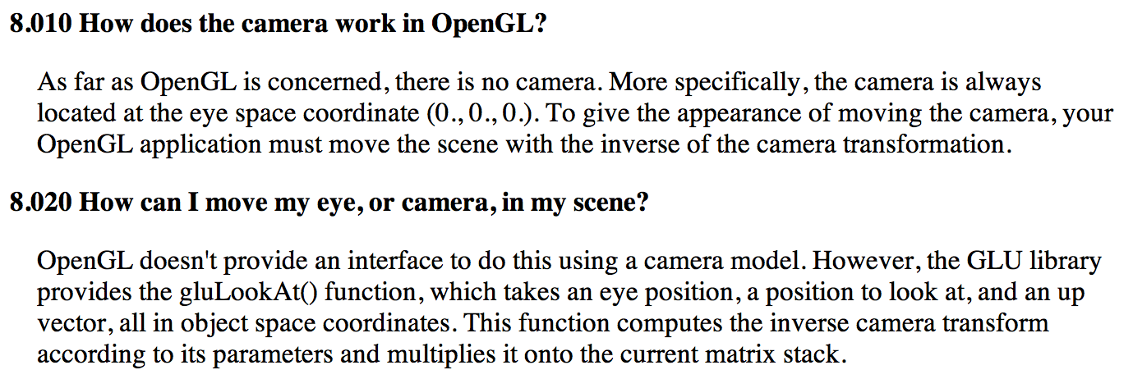
The Camera Transformation
Source: www.opengl.org/archives/resources/faq/technical/viewing.htm

Slide 83
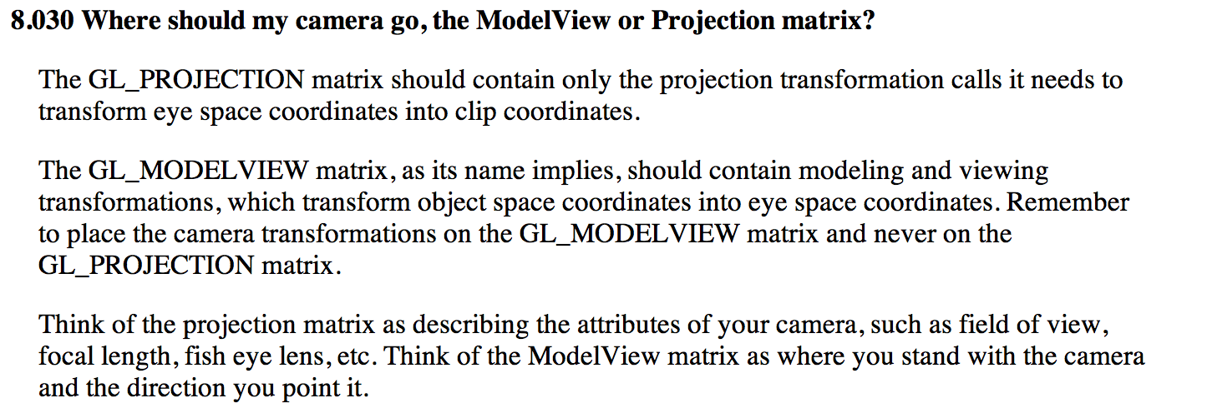
The Camera Transformation
Source: www.opengl.org/archives/resources/faq/technical/viewing.htm

Slide 84
How do you put the Camera Transform in the ModelView matrix?
No single GL call.
Options are:
(1) you do it yourself (i.e., calculate matrix and load it into OpenGL)
(2) you use somebody’s code, i.e., gluLookAt
(3) you use a combination of glRotatef, glScalef, and glTranslatef commands.

Slide 85
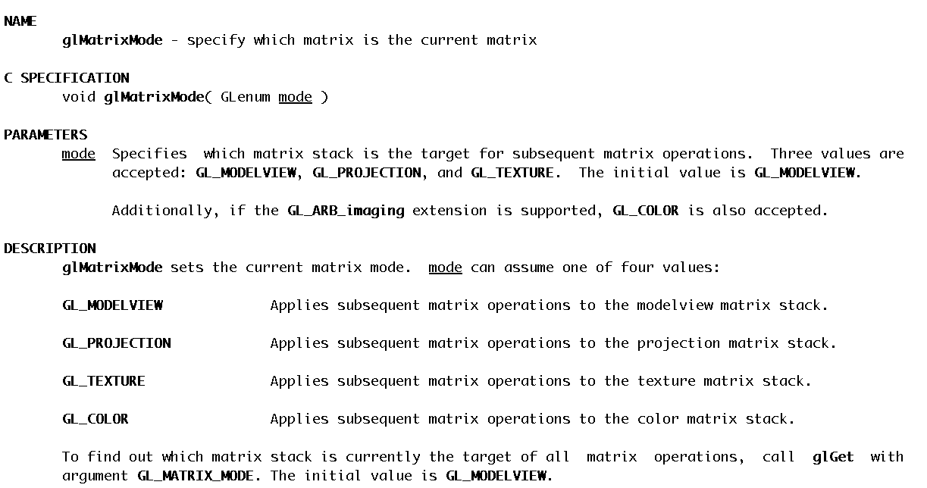
glMatrixMode

Slide 86
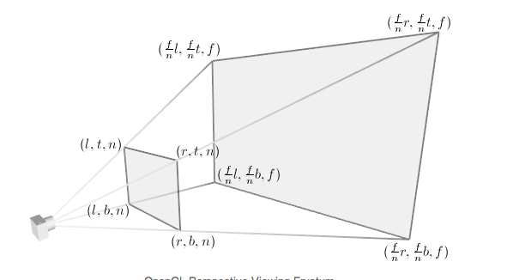
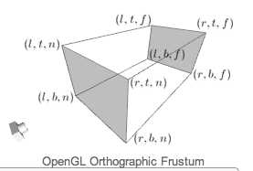
How do you put the projection transformation in GL_PROJECTION?
Two options:
glFrustum() (perspective projection)
glOrtho() (orthographic projection)

Slide 87
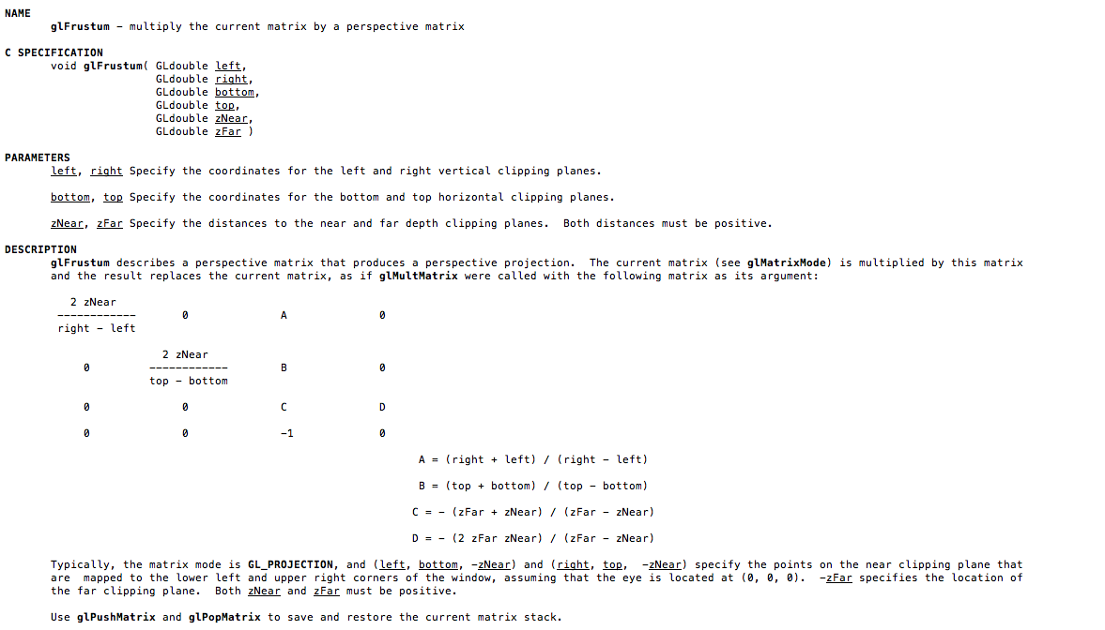
glFrustum

Slide 88

glOrtho

Slide 89


glMatrixMode(GL_TEXTURE)

Slide 90
Project 2B

Slide 91

Project #2B (7%), Due Weds Feb 27th
Goal: modify ModelView matrix to create dog out of spheres and cylinders
New code skeleton: “project2B.cxx”
No geometry file needed.
You will be able to do this w/ glPush/PopMatrix, glRotatef, glTranslatef, and glScalef.

Slide 92

Project #2B (7%), Due Weds Feb 27th
Goal: modify ModelView matrix to create dog out of spheres and cylinders
New code skeleton: “project2B.cxx”
No geometry file needed.
You will be able to do this w/ glPush/PopMatrix, glRotatef, glTranslatef, and glScalef.

Slide 93
Contents of project2B.cxx
Routine for generating spheres
Routine for generating cylinders
Routine for generating head, eyes, and pupils

Slide 94
What is the correct answer?
The correct answer is:
Something that looks like a dog
No obvious problems with output geometry.
Something that uses the sphere and cylinder classes.
If you use something else, please clear it with me first.
I may fail your project if I think you are using outside resources that make the project too easy.
Something that uses rotation for the neck and tail.
Aside from that, feel free to be as creative as you want … color, breed, etc.

Slide 95


Slide 96


Slide 97


Slide 98


Slide 99

For your reference: my dog

Slide 100
Transparent Geometry

Slide 101
Compositing and Blending
Ed Angel
Professor of Computer Science, Electrical and Computer Engineering, and Media Arts
University of New Mexico

Slide 102

Opacity and Transparency
Opaque surfaces permit no light to pass through
Transparent surfaces permit all light to pass
Translucent surfaces pass some light
translucency = 1 – opacity (α)
opaque surface α =1

Slide 103
Transparency
If you have an opaque red square in front of a blue square, what color would you see?
Red
If you have a 50% transparent red square in front of a blue square, what color would you see?
Purple
If you have a 100% transparent red square in front of a blue square, what color would you see?
Blue

Slide 104
(One) Formula For Transparency
Front = (Fr,Fg,Fb,Fa)
a = alpha, transparency factor
Sometimes percent
Typically 0-255, with 255 = 100%, 0 = 0%
Back = (Br,Bg,Bb,Ba)
Equation = (Fa*Fr+(1-Fa)*Br, Fa*Fg+(1-Fa)*Bg, Fa*Fb+(1-Fa)*Bb, Fa+(1-Fa)*Ba)

Slide 105
Transparency
If you have an 25% transparent red square (255,0,0) in front of a blue square (0,0,255), what color would you see (in RGB)?
(192,0,64)
If you have an 25% transparent blue square (0,0,255) in front of a red square (255,0,0), what color would you see (in RGB)?
(64,0,192)

Slide 106
Implementation
Per pixel storage:
RGB: 3 bytes
Alpha: 1 byte
Z: 4 bytes
Alpha used to control blending of current color and new colors

Slide 107

Vocab term reminder: fragment
Fragment is the contribution of a triangle to a single pixel
Almost certain to use
term “fragment” on midterm
and expect that you know
what it means

Slide 108
Examples
Imagine pixel (i, j) has:
RGB = 255/255/255
Alpha=255
Depth = -0.5
And we contribute fragment:
RGB=0/0/0
Alpha=128
Depth = -0.25
What do we get?
Answer: 128/128/128, Z = -0.25
What’s the alpha?

Slide 109
Examples
Imagine pixel (i, j) has:
RGB = 255/255/255
Alpha=128
Depth = -0.25
And we contribute fragment:
RGB=0/0/0
Alpha=255
Depth = -0.5
What do we get?
Answer: (probably) 128/128/128, Z = -0.25
What’s the alpha?

Slide 110
System doesn’t work well for transparency
Contribute fragments in this order:
Z=-0.1
Z=-0.9
Z=-0.5
Z=-0.4
Z=-0.6
Model is too simple. Not enough info to resolve!

Slide 111

Order Dependency
Is this image correct?
Probably not
Polygons are rendered
in the order they pass
down the pipeline
Blending functions
are order dependent

Slide 112
How do you sort?
1) Calculate depth of each triangle center.
2) Sort based on depth
Not perfect, but good
In practice: sort along X, Y, and Z and use “dominant axis” and only do “perfect sort” when rotation stops

Slide 113
But there is a problem…
(0, 1, -0.4)
(0, 1.5, -0.4)
(-1, -1, -0.3)
(1, -1, -0.5)
(-2, -1.5, -0.5)
(2, -1.5, -0.3)

Slide 114
Depth Peeling
a multi-pass technique that renders transparent polygonal geometry without sorting
Pass #1:
render as opaque, but note opacity of pixels placed on top
treat this as “top layer”
save Z-buffer and treat this as “max”
Pass #2:
render as opaque, but ignore fragments beyond “max”
repeat, repeat…

